Slide 1
ADIDAS SALES PERFORMANCE: AN INTERACTIVE
DASHBOARD
By Shawn Thomas
Data Analyst Internship
Task 3: Dashboard Design & Summary

Slide 2
Project Objective
Objective: To design and build an interactive dashboard in Power BI for business stakeholders.
Key Goals:
Visualize Key Metrics: Clearly display Key Performance Indicators (KPIs) such as Total Sales, Total Profit, and Profit Margin.
Enable Data Storytelling: Analyze sales trends over time to understand business performance.
Ensure Interactivity: Allow stakeholders to dynamically filter and explore data by Year, Region, and Product Category.
Deliver Actionable Insights: Move beyond just numbers to provide clear, decision-driving insights.

Slide 3
Our 4-Step Process
1. Extract & Transform (ETL)
Connected to the AdidasSalesdata.csv dataset.
Used Power Query to clean data, verify correct data types (e.g., dates, currency, percentages), and ensure data integrity.
Renamed columns for clarity.
2. Model
Built a best-practice "Star Schema" data model.
Created a separate Dates Table to enable robust time-series analysis.
Formed a relationship between the Dates table and the Sales table.

Slide 4
3. Define (DAX)
Wrote DAX (Data Analysis Expressions) formulas to create key business measures:
Total Sales
Total Profit
Avg Profit Margin
Total Units Sold
4. Visualize & Design
Designed a multi-page report with a clean, consistent theme.
Used navigation buttons to guide the user's "story" from a high-level summary to a detailed breakdown.

Slide 5
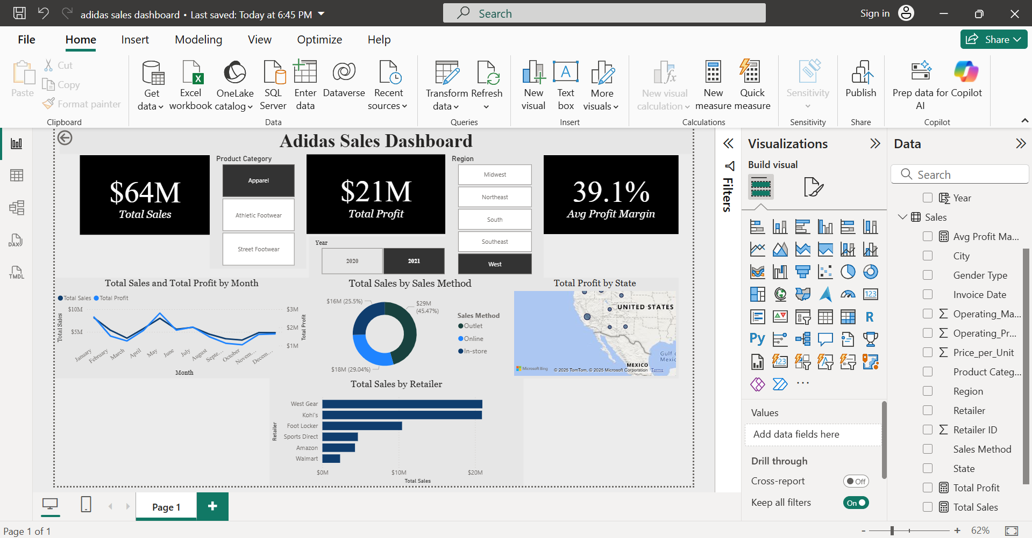
Executive Dashboard Overview
Key Components:
KPI Cards: At-a-glance summary of Total Sales, Total Profit, and Avg Profit Margin.
Interactive Slicers: Dropdown filters for Year, Region, and Product Category.
Time-Series Analysis: A line chart tracking Total Sales and Total Profit by month, fulfilling a core task requirement.
Geographic & Product Breakdown: A Map visual showing profit by state and a Donut Chart showing the sales mix by category.

Slide 6
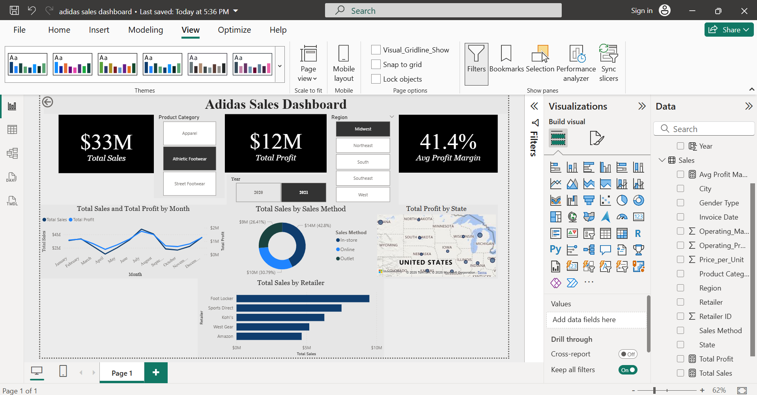
Key Insights & Findings
1. Top-Line Performance:
The business generated $33M Total sales in the Product category Athletic Footwear year 2021 in the Region “Midwest”, resulting in $12M Total Profit .
The average profit margin across all sales was 41.4% Avg Profit Margin.
2. Sales Channel Strategy:
"Online" sales proved to be the most profitable channel, with an average margin of 30.79%, while "Outlet" had a lower margin of 26.41%.
Insight: This suggests an opportunity to drive more high-margin online sales.

Slide 7
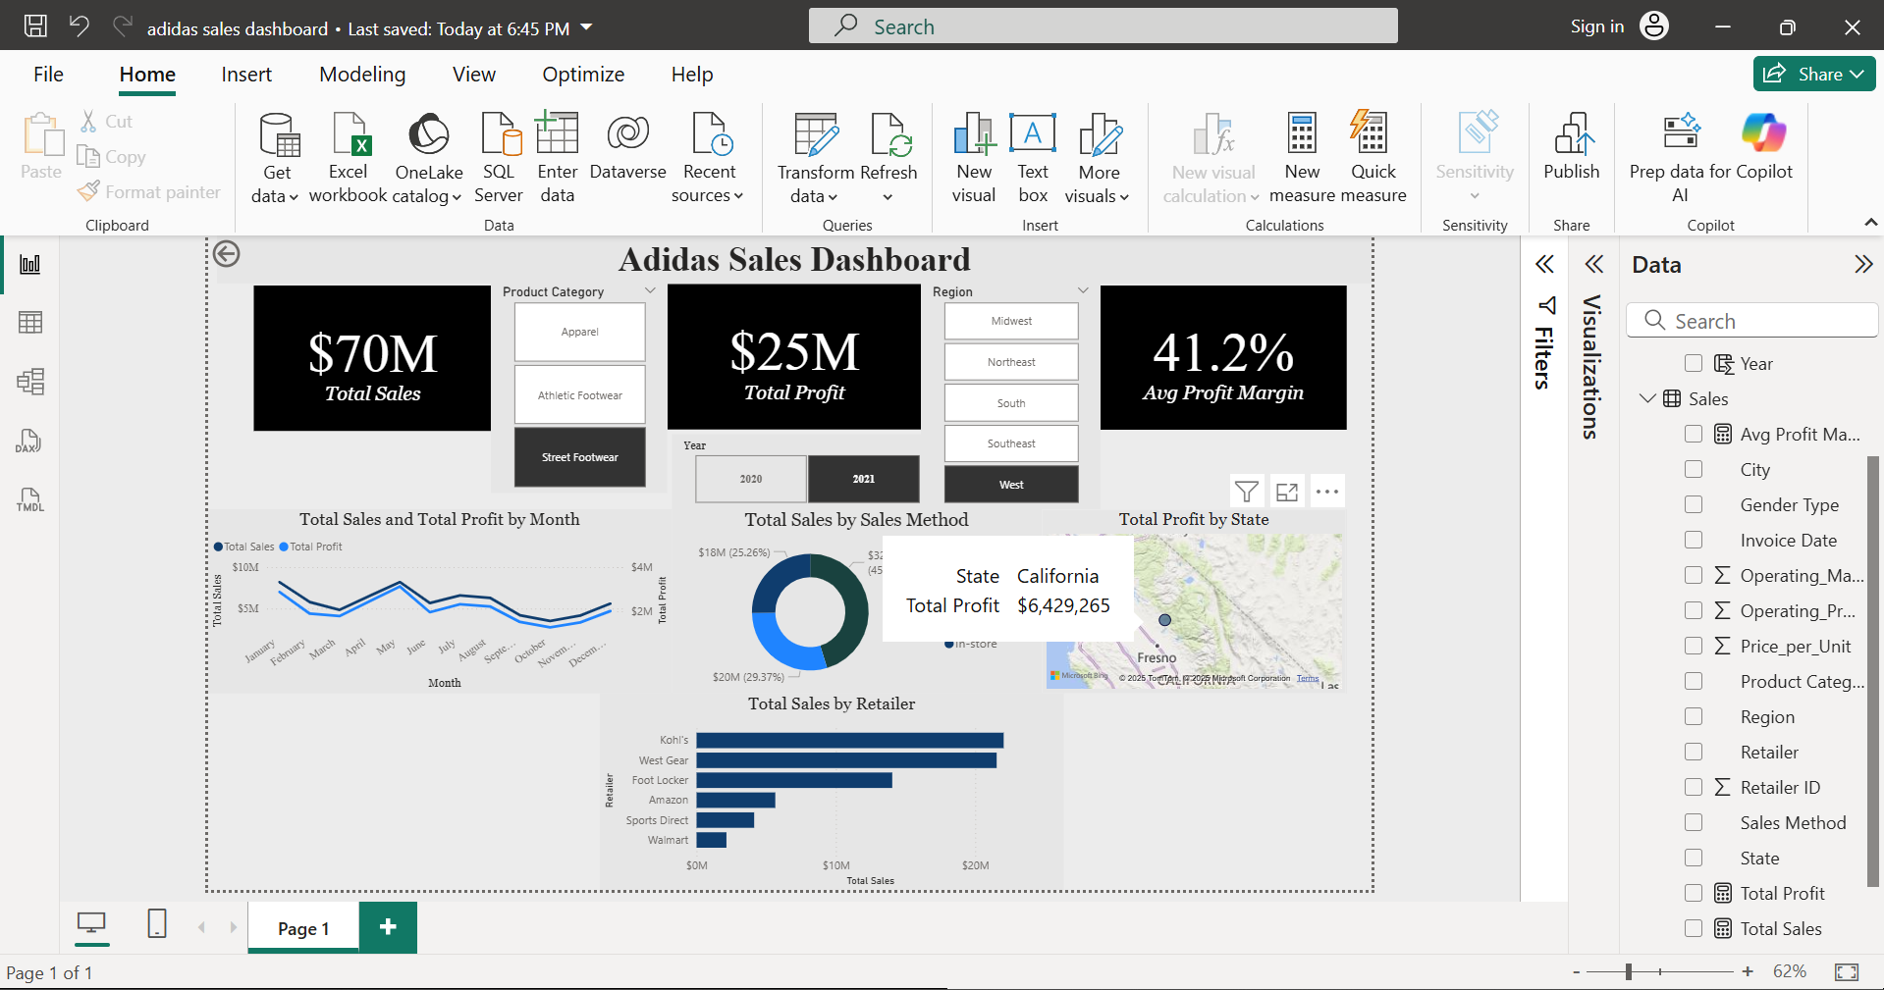
3. Product & Regional Champions:
The "West" region was the most profitable, driven primarily by sales in "California".
"Men's Street Footwear" was the single most dominant product category, accounting for nearly 20% of all sales.
4. Seasonal Trends:
As shown in the time-series chart, sales and profit see a significant peak in "October-December 2021", aligning with the holiday season.

Slide 8
Dashboard Features
Dynamic Filtering: All visuals on the page can be filtered instantly using the slicers for:
Year
Region
Product Category
Gender Type
Cross-Filtering: The dashboard is fully interactive. Clicking a bar in the "Sales by Retailer" chart will automatically filter the map, line chart, and KPI cards to show data only for that retailer.
Page Navigation: Buttons allow users to seamlessly move between the "Executive Summary" and the "Product & Retailer Deep-Dive" pages for more detail.
Consistent Theme: A clean, professional theme was applied to make the dashboard easy to read and use for business presentations.

Slide 9
CONCLUSION
This Power BI dashboard successfully centralizes Adidas sales data into an interactive and insightful tool.
It answers key business questions regarding "what" (KPIs), "when" (trends), and "where" (regions/products) the business is performing best.

Slide 10
THANK YOU

